Slide 1
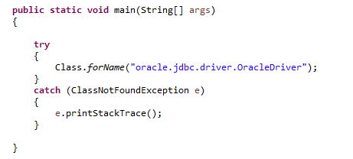
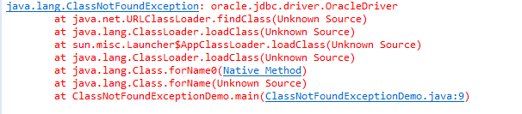
ClassNotFoundException Vs. NoClassDefFoundError
ClassNotFoundException is a run time exception which is thrown when an application tries to load a class at run time using Class.forName() or loadClass() or findSystemClass() methods and the class with specified name are not found in the classpath. For example, you may have come across this exception when you try to connect to MySQL or Oracle databases and you have not updated the classpath with required JAR files. In most of time, this exception occurs when you try to run an application without updating the classpath with required JAR files.
If we run the above program without updating the classpath with required JAR files, we will get the exception like below,

Slide 2
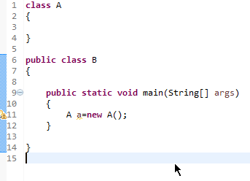
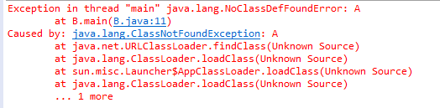
ClassNotFoundException Vs. NoClassDefFoundError
NoClassDefFoundError is an error which is thrown when Java Runtime System tries to load the definition of a class and class definition is no longer available. The required class definition was present at compile time but it was missing at run time.
When you compile the above program, two .class files will be generated. One is A.class and another one is B.class. If you remove the A.class file and run the B.class file, Java Runtime System will throw NoClassDefFoundError.

Slide 3
ClassNotFoundException Vs. NoClassDefFoundError
ClassNotFoundException | NoClassDefFoundError
It is an exception. It is of type java.lang.Exception. | It is an error. It is of type java.lang.Error.
It occurs when an application tries to load a class at run time which is not updated in the classpath. | It occurs when java runtime system doesn’t find a class definition, which is present at compile time, but missing at run time.
It is thrown by the application itself. It is thrown by the methods like Class.forName(), loadClass() and findSystemClass(). | It is thrown by the Java Runtime System.
It occurs when classpath is not updated with required JAR files. | It occurs when required class definition is missing at run time.

